Slide 1
BMI508 – Fall 2026
Introduction to Biomedical Ontology
Class 6 – Sept 30, 2026
General principles for realism-based ontology development
Werner CEUSTERS
Department of Biomedical Informatics, University at Buffalo, USA

Slide 2
Last week’s extra credit opportunity: correct the axioms so that 2 distinct processes can occupy the same STR.
If a process is part of another, their spatiotemporal regions are part too:
(forall (p1 p2)
(if (and (exists (t) (instance-of p1 process t)) (exists (t) (instance-of p2 process t)))
(iff (occurrent-part-of p1 p2)
(exists (st1 st2)
(and (occupies-spatiotemporal-region p1 st1) (occupies-spatiotemporal-region p2 st2) (occurrent-part-of st1 st2))))))
Occurrent-part-of is antisymmetric:
(forall x y) (if (and (occurrent-part-of x y)
(occurrent-part-of y x))
(= x y)))

Slide 3
Reading pre-class
R5 Principles of best practice I and II. (pages 43-84) in: Arp, R., B. Smith, and A.D. Spear, Building ontologies with basic formal ontology. 2015, The MIT Press,: Cambridge, Massachusetts. p. 1 online resource (245 p.) [1]

Slide 4
Readings for next week
Required:
R7: The ontology of relations. (pages 131-150) in: Arp, R., B. Smith, and A.D. Spear, Building ontologies with basic formal ontology. 2015, The MIT Press,: Cambridge, Massachusetts. p. 1 online resource (245 p.)
Strongly suggested:
R6: Smith, B., et al., Relations in biomedical ontologies. Genome Biol, 2005. 6(5): p. R46.

Slide 5
Class overview
General re-introduction of ‘ontology’ versus ‘terminology’
Terminology selection and management
Definitions
Ontology design / putting it together:
  lessons learned from A3
  How to transform A3 into A4 (demo)
5

Slide 6
Ontology ←→ Terminology

Slide 7
OASAS data checking instructions
[CHILDREN_LIVING_WITH_CLIENT] must be a whole number between 0 and 9
If [PRIMARY_SUBSTANCE_CODE] is 0 (none), then [PRIMARY_AGE_OF_FIRST_USE] must be space filled.
[PRIMARY_AGE_OF_FIRST_USE] cannot be greater than the age at admission.
[PREGNANT]
  [PREGNANT] must be either 1 (Yes) or 2 (No).
  If [SEX] is 1 (Male), [PREGNANT] cannot be 1 (Yes).
https://apps.oasas.ny.gov/portal/page/portal/OASAS_APPS/CDS_Public_Documentation/TAB38646/Tab/CDS_Batch_Transaction_File_Specification_0.pdf
7

Slide 8
Two important science- and research- related disciplines
Ontology
Terminology

Slide 9

Two important science- and research- related disciplines
Ontology
What entities exist?
How do entities relate to each other?
Terminology
What entities, if any at all, are denoted by words or terms?
How do terms relate to each other?
How to form declarative terms?
‘Earth’ ‘Aarde’ ‘La Terre’
Reality first
Representation first

Slide 10
Canonical case: faithful representation
Reality
Representation
‘Earth’
‘Aarde’
‘La Terre’
…
denotes
means
represents

Slide 11
Delusions, fantasies, imaginations, …
Reality
Representation
‘unicorn’

Slide 12
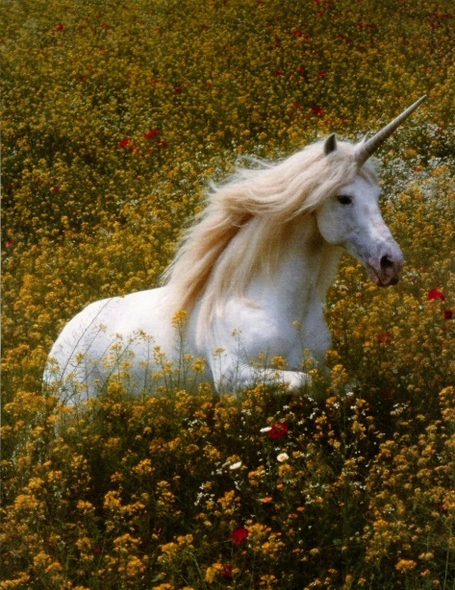
Delusions, fantasies, imaginations, …
Reality
Representation
‘unicorn’

Slide 13

Delusions, fantasies, imaginations, …
Terminology
Reality
Representation
‘unicorn’
Graphics

Slide 14
Delusions, fantasies, imaginations, …
Conceptualism
Terminology
Reality or
Imagination
Representation
‘unicorn’
Graphics
unicorn concept

Slide 15
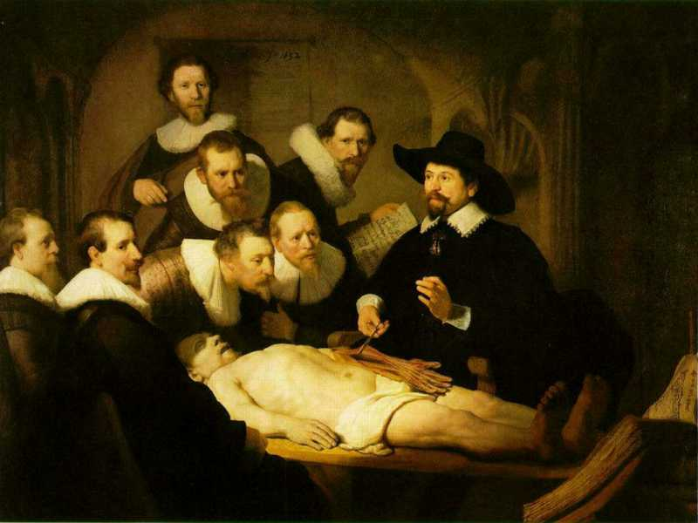
Three levels of reality
L1: what is the case
ontos
L2: what we believe
thought
logos
word / speech
L3: what we
communicate
Rembrandt van Rijn, The Anatomy Lesson of Dr. Nicolaes Tulp, 1632. Oil on canvas, 169.5cm x 216.5cm (Mauritshuis, The Hague)
Notes:
https://www.thewoventalepress.net/2018/02/12/an-anatomy-lesson/

Slide 16
Semiotic / semantic triangle
(Ogden & Richards, 1923:
The meaning of ‘meaning’)
concept
term
referent

Slide 17
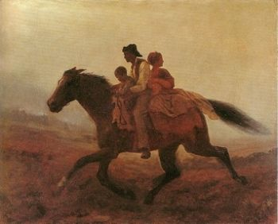
Prehistoric ‘psychiatry’: drapetomania
disease which causes slaves to suffer from an unexplainable propensity to run away
…
concept
term
referent
painting by Eastman Johnson. A Ride for Liberty: The Fugitive Slaves. 1860.
‘drapetomania’

Slide 18
Exercise: what may be the case in reality?
Reality
Representation
‘disorder’
‘disease’
‘illness’
‘sickness’

Slide 19
Exercise: what may be the case in reality?
Reality
Representation
‘disorder’
‘disease’
‘illness’
‘sickness’
U1
Synonymous-with

Slide 20
Exercise: what may be the case in reality?
Reality
Representation
U1
‘disorder’
‘disease’
‘illness’
‘sickness’
U2

Slide 21
Exercise: what may be the case in reality?
Reality
Representation
U1
‘disorder’
‘disease’
‘illness’
‘sickness’
U2
U3
U4

Slide 22
Exercise: what may be the case in reality?
Reality
Representation
U1
‘disorder’
‘disease’
‘illness’
‘sickness’
U2
U3
U4

Slide 23
How can we find out?

Slide 24
Term types
Natural language terms:
  Terms used in everyday language;
    → dictionaries
Technical terms:
  Terms used in technical language;
    → domain specific dictionaries
Type-terms:
  Terms used in ‘knowledge representations’:
    Denoting ‘concepts’ in (formal terminologies);
    Referring to universals (or defined classes) in realism-based ontologies → type-terms

Slide 25

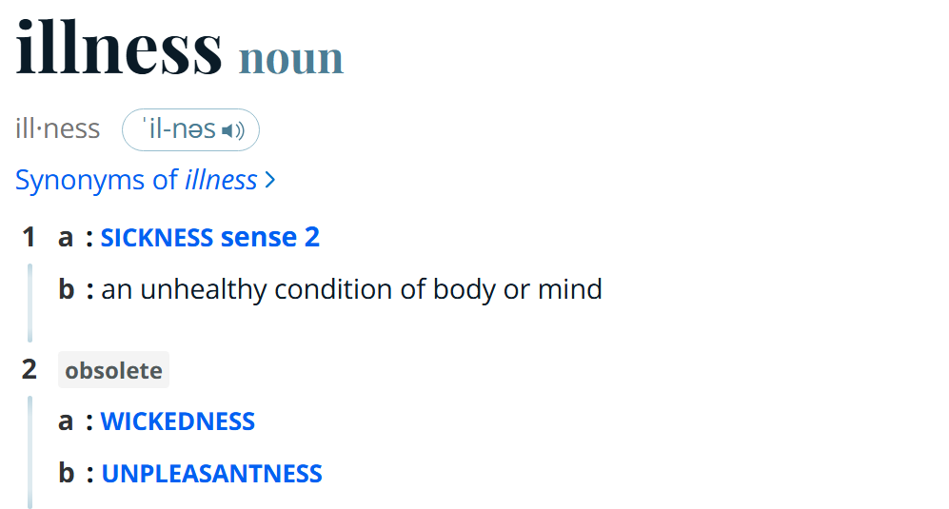
‘Illness’ in Merriam-Webster
https://www.merriam-webster.com/

Slide 26
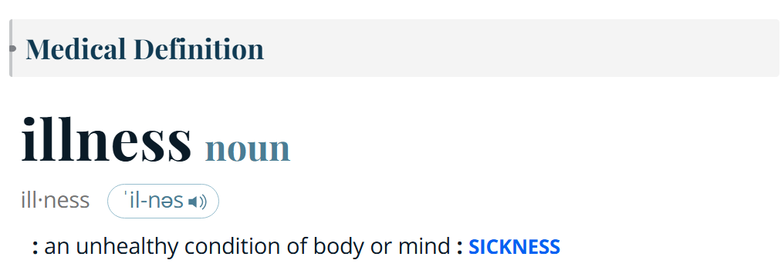
‘Illness’ in Merriam-Webster
https://www.merriam-webster.com/

Slide 27
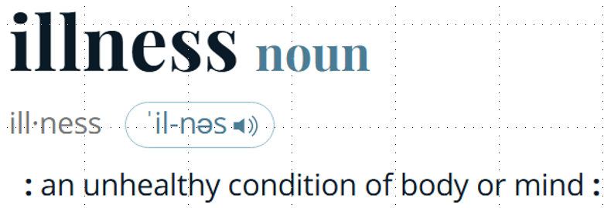
What is the case ?
Reality
Representation
‘illness’
illness

Slide 28
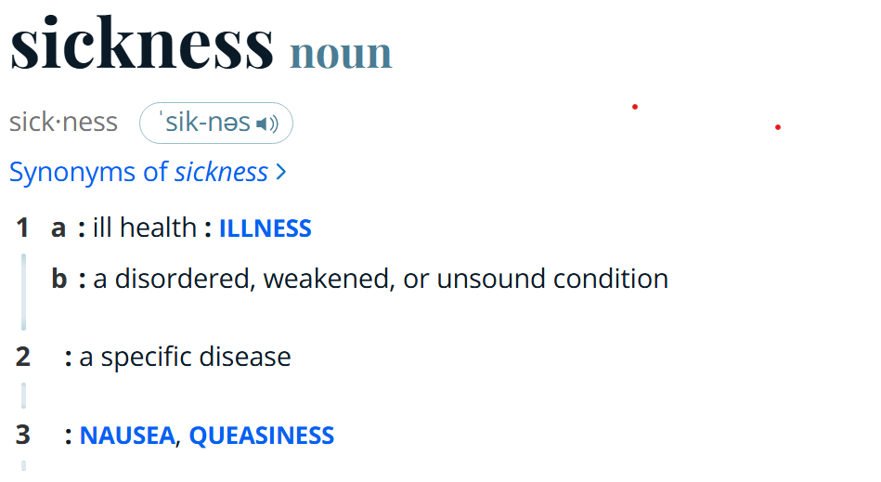
‘Illness’ in Merriam-Webster
https://www.merriam-webster.com/

Slide 29
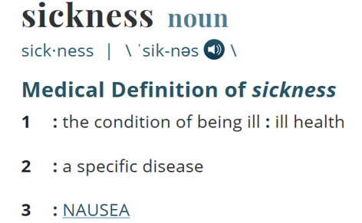
What is the case ?
Reality
Representation
‘illness’
Specific disease
=?
Homonymy
nausea
‘sickness’
illness
Synonyms?

Slide 30
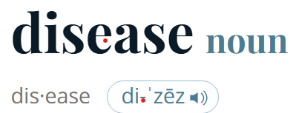
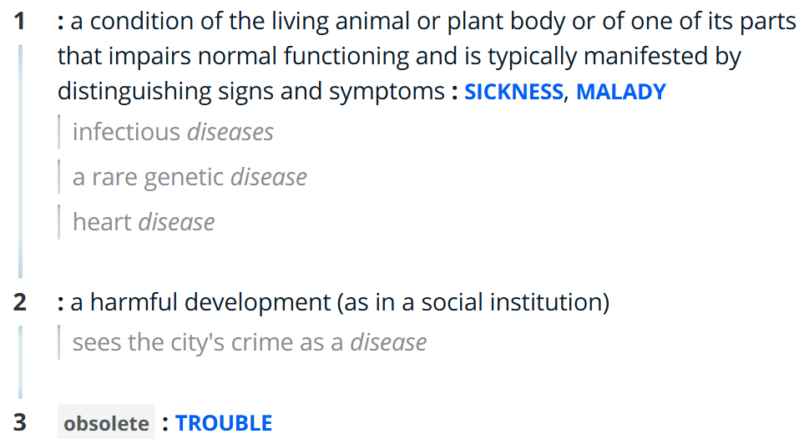
‘Illness’ in Merriam-Webster
https://www.merriam-webster.com/

Slide 31
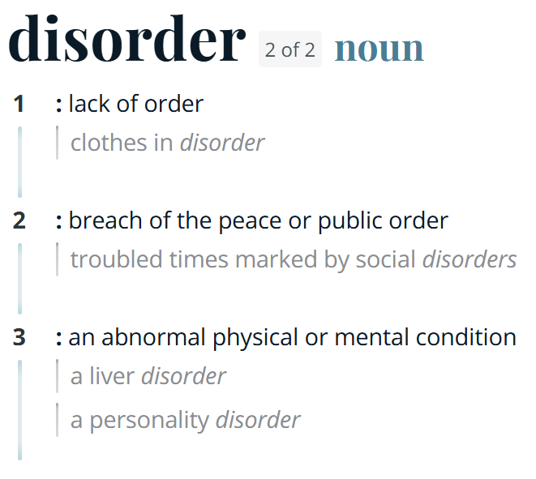
‘Illness’ in Merriam-Webster
https://www.merriam-webster.com/

Slide 32
Better general strategy
(than consulting dictionaries)
Use terminology and metaphysics:
To make decisions on what entities to represent in the ontology,
To define type-terms for these entities precisely,
…

Slide 33
Metaphysical inquiry as a start
Define terms precisely so that what is intended by (ideally) all uses of the corresponding terms in the language under scrutiny falls under it;
Investigate how what is intended by these uses relate to each other.
Example: the ‘Bio-Psycho-Social Perspective’ on disease

Slide 34
The objective Bio-Psycho-Social perspective
‘T_{o}-Disease’:
  a health problem that consists of a physiological malfunction that results in an actual or potential reduction in physical capacities and/or a reduced life expectancy
‘T_{o}-Illness’:
  a subjectively interpreted undesirable state of health, consisting of subjective feeling states (e.g., pain, weakness), perceptions of the adequacy of their bodily functioning, and/or feelings of competence
‘T_{o}-Sickness’:
  a social entity in virtue of the poor health or the health problem(s) of an individual defined by others with reference to the social activity of that individual
Twaddle, A. (1994a). Disease, illness and sickness revisited.
In: A. Twaddle & L. Nordenfelt. (Eds.) Disease, Illness and Sickness: Three Central Concepts in the Theory of Health
(pp. 1–18). Link€oping: Studies on Health and Society, 18.

Slide 35
The subjective Bio-Psycho-Social perspective
T_{s}-Disease:
  when there are negative bodily occurrences as conceived of by the medical profession.
T_{s}-Illness:
  when there are negative bodily occurrences as conceived of by the person himself.
T_{s}-Sickness:
  when there are negative bodily occurrences as conceived of by the society and/or its institutions.
‘Occurrence’ here means ‘process’, ‘state’ or ‘event’.
Bjørn Hofmann. On the Triad Disease, Illness and Sickness.
Journal of Medicine and Philosophy 2002, Vol. 27, No. 6, pp. 651–673

Slide 36
Overlap in the subjective Bio-Psycho-Social perspective
T_{s}-Illness (patients)
6
3
4
1
5
7
2
T_{s}-Disease
(MDs)
T_{s}-Sickness
(society)
Bjørn Hofmann. On the Triad Disease, Illness and Sickness.
Journal of Medicine and Philosophy 2002, Vol. 27, No. 6, pp. 651–673

Slide 37
General strategy
Use terminology and metaphysics:
To make decisions on what type-terms to include in the ontology,
To define these type-terms precisely,
To create for each type-term a synonym-list indicating which terms in biomedical language tend to be used to refer to what is intended by your type-terms

Slide 38
The ontological approach
Reality
Representation
Entity1
‘term1’
‘term2’
Entity2
‘term3’
Entity3

Slide 39
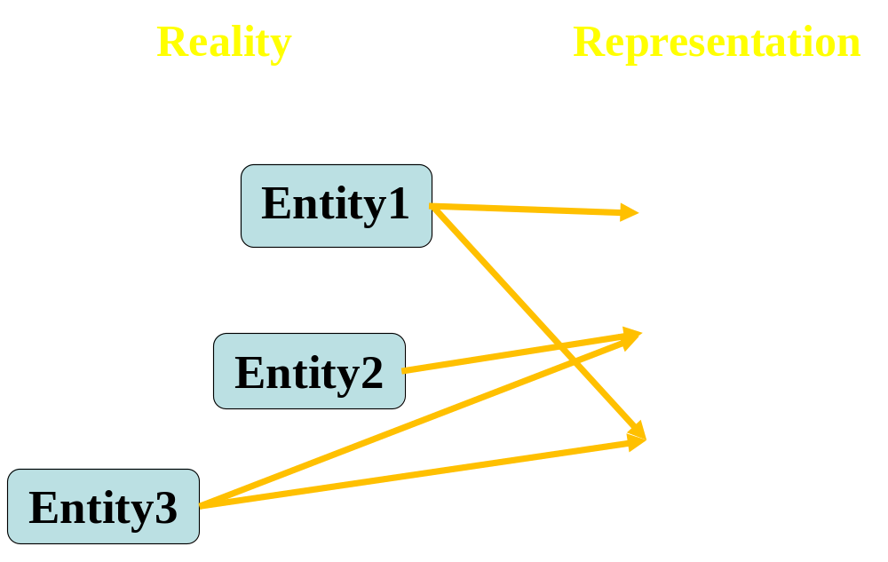
‘Type-terms’ ←→ ‘language terms’
Type-terms
language-terms

Slide 40
Requirements for type-terms
Use singular nouns
No acronyms (acronyms may serve as synonyms)
No mass nouns; use only count nouns
Use lower-case except for proper names
Add to each type-term a symbolic-name per BFO2020-FOL CLIF convention
Ensure univocity (do not use as type-term a homonymous term)
Use terms which have face-validity
Do not name type-terms through logical combinations of other type-terms.
Use complements of type-terms only in very special circumstances and only when there is no other way
Provide an adequate definition
List commonly used synonyms in a separate list
Write for each type-term a BFO2020-FOL style CLIF axiom expressing its position in the taxonomy

Slide 41
Assignment
A4: Apply the principles for term selection, replacement, formatting and definitions, discussed in class and in R5 to all the terms in your ontology so as to create version 2 (but keep version 1 as well as all later versions. You will need them for a later assignment!)
Draw the taxonomy using indentations
Upload your work to the UB Box assignment folder.
Detailed document layout: see demo at end of class.
Name of the file: ‘BMI508-A4-[ubitname].docx’.
Note: Keep the numbering of the assignment as indicated here in the syllabus.
Due date: October 9 – 6pm. (not Oct 5-noon as per syllabus)

Slide 42
configuration | reality |  | representation |  |  |  | ME
 |  |  | authors' belief |  | encoding
 | OE | OR | BE | BR | IE | TR
(1) | (2) | (3) | (4) | (5) | (6) | (7) | (8)
P+1 | Y | Y | Y | Y | Y | R+ | 0
A+1 | N | na | N | na | na | na | 0
A+2 | Y | N | Y | N | na | na | 0
A+3 | Y | N | NC | na | na | na | 0
A+4 | N | na | NC | na | na | na | 0
P-1 | N | na | Y | Y | Y | ¬R | 3
P-2 | N | na | Y | Y | N | ¬R | 4
P-3 | N | na | Y | Y | N | R– | 5
P-4 | Y | Y | Y | Y | N | ¬R | 1
P-5 | Y | Y | Y | Y | N | R- | 2
P-6 | Y | N | Y | Y | Y | R+ | 1
P-7 | Y | N | Y | Y | N | ¬R | 2
P-8 | Y | N | Y | Y | N | R– | 3
P-9 | Y | Y | Y | Y | Y | R++ | 1
P-10 | Y | N | Y | Y | Y | R++ | 2
P-11 | Y | Y | Y | Y | Y | Ra | 1
P-12 | N | na | Y | Y | Y | Ra | 4
A-1 | Y | Y | Y | N | na | na | 1
A-2 | Y | Y | N | na | na | na | 1
A-3 | N | na | Y | N | na | na | 1
A-4 | Y | N | N | na | na | na | 1
A-5 | Y | Y | NC | na | na | na | 1

Slide 43
Requirements for text definitions
Use only Aristotelian definitions
  An A is B which C, D, …
    ‘An A is a B’: anything that is an instance of A at some time t, is an instance of B at that time t ;
    ‘which C’: anything that is an instance of A at some time t, stands (at time t1) in some relation R to something that is an instance of C at t.
    Draw the taxonomy formed by all As as a tree, thereby ensuring that all defined ‘highest’ As are subsumed by a BFO-type.
Use only essential features for R-C’s, if possible a necessary and sufficient set
Use only relations from BFO2020 which do not have a red background in bfo-2020-defhelp.xlsx (uploaded to UB Box). If you use a non-BFO relation, it must be defined too!
Start with defining most general type-terms.
Every A can have only one B.
No circularity IN or OVER definitions.

Slide 44
A4 assessment
All relevant entities must be listed, i.e.
  the ones denoted by domain terms used in A3 as ‘term’ or inside a motivation (changes and rejections are allowed, see further),
  the ones used in definitions in A4 (except BFO type-terms).
All these entities must be given:
  A unique ID (whether intention kept as is, changed or obsoleted)
  an adequate type-term,
  A properly formatted symbolic name,
  an adequate definition, and
  at least one synonym different from the type-term.
Type-terms must satisfy the type-term requirements
Definitions must satisfy the definition requirements
Any of the above requirements (in this and previous slides) not satisfied for any domain entity: -1% per missed requirement.

Slide 45
Demo

